Slide 1
Big Mountain Resort - Guided Capstone

Slide 2
Context
Big Mountain Resort is a ski resort in Montana that offers spectacular views on Glacier National Park and Flathead National Forest. Recently, the resort has installed an additional chairlift to help increase the distribution of visitors across the mountain. The chair will increase costs by $1,540,000 this season. The business wants to change their pricing strategy to get an even better value out of their ticket price. Either by cutting costs or having a higher ticket price.
What opportunities are there for Big Mountain Resort to increase their value of tickets either by cutting costs or by increasing ticket prices to make up for the operational costs of having an additional chair lift installed?
Problem Statement

Slide 3
Recommendations
Our model suggests that Mountain Resort’s ticket price is lower than the predicted model by 18.36%, Big Mountain Resort’s price should be $95.87. The resort gave us 4 potential scenarios for either cutting costs by closing runs or increasing ticket price by increasing vertical drop, adding acres snow making or increasing the longest run.
Our model shows that increasing vertical drop by 150, supports for ticket price by $1.99. Over the season, this could be expected to amount to $3,474,638.

Slide 4
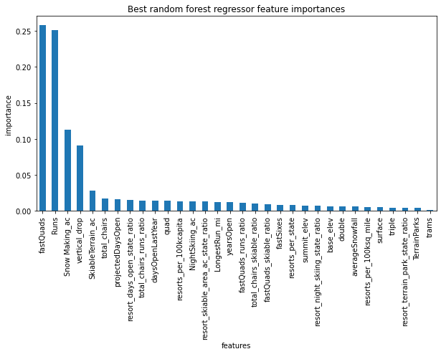
Model Analysis
A random forest model was used for this problem due to its performance compared to a linear regression model
The random forest model ranked a number of features on importance

Slide 5
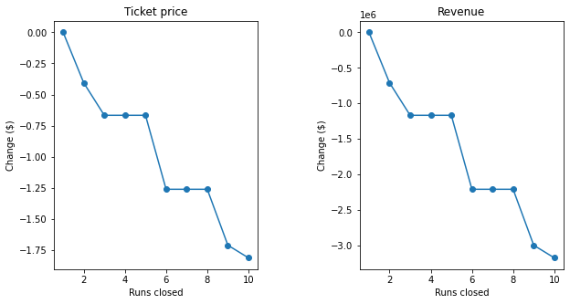
Scenario 1 - Permanently closing up to 10 runs
Our model shows that shutting down 1 run will have no effect on ticket price or revenue. However, closing 2 runs will reduce ticket price and revenue. Shutting down 3 runs is the same as shutting down 4 or 5 runs. The pattern also repeats on shutting down 6 runs. We can expect the same amount of revenue loss when we shut down 7 or 8 runs as we do when we shut down 6 runs.

Slide 6
Scenario 2 - Increase number of runs by 1, and increase vertical drop by 150
This scenario increases support for ticket price by $1.99, a 2.46% increase. Over the season, this could be expected to amount to $3,474,638.

Slide 7
Senario 3 - Add an additional run, increase vertical drop by 150, and add 2 acres of snow making
Our model shows that the increase in ticket price would be the exact same as scenario 2. This small amount of snowmaking is not enough to make a difference in our model

Slide 8
Senario 4 - Increase the longest run by 0.2 mile, requiring additional snow making coverage of 4 acres
This model showed that there was no change to ticket price or revenue price when accounting for this change.

Slide 9
Conclusion
The best scenario is scenario 2.
We saw an increase of 2.46% on ticket price when we increased the vertical drop by 150 ft, adding one run, installing an additional chair lift and adding 2 acres of snow making cover.
This scenario increased revenue by $13,474,638

